Slide 1
Chapter 4. instrumental regression
Financial Econometrics
Department of financial engineering
Zhongnan university of economics and law
Xu Yonghao

Slide 2
oUTLINE
Introduction: endogeneity problem
IV estimation
Two Stage Least Squares
Two specification tests

Slide 3
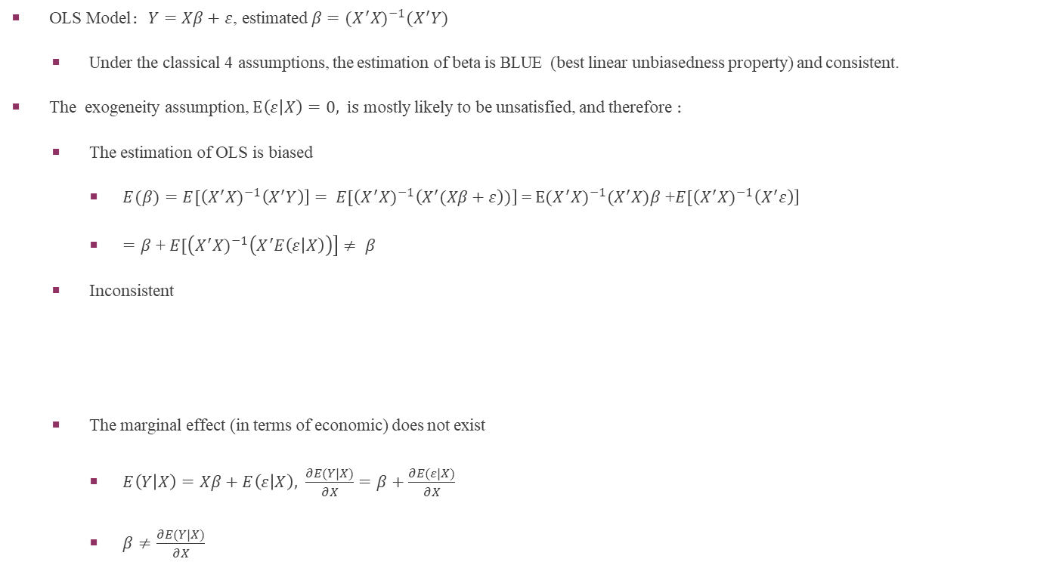
1 Introduction: endogeneity problem
OLS Model：$Y=Xβ+ε$, estimated$β=(X^{′}X)^{−1}(X^{′}Y)$
Under the classical 4 assumptions, the estimation of beta is BLUE (best linear unbiasedness property) and consistent.
The exogeneity assumption, $E\left(ε | X\right)=0, is$ mostly likely to be unsatisfied, and therefore ：
The estimation of OLS is biased
$E(β)=E[\left(X^{′}X)^{−1}\left(X^{′}Y\right)\right]= E[\left(X^{′}X)^{−1}\left(X^{′}(Xβ+ε\right))\right]$ = $E{(X}^{′}X)^{−1}{(X}^{′}X)β$ +$E[\left(X^{′}X)^{−1}\left(X^{′}ε\right)\right]$
$=β$ + $E[\left(X^{′}X)^{−1}\left(X^{′}E\left(ε | X\right)\right)\right]≠ β$
Inconsistent
The marginal effect (in terms of economic) does not exist
$E\left(Y | X\right)=Xβ+E\left(ε | X\right), \frac{∂E(Y|X)}{∂X}=β+\frac{∂E(ε|X)}{∂X}$
$β≠\frac{∂E(Y|X)}{∂X}$

Slide 4
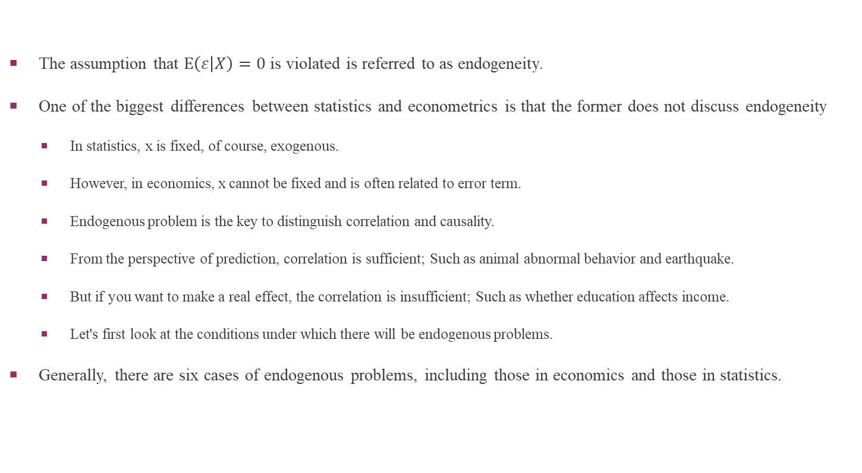
1 Introduction: endogeneity problem
The assumption that $E\left(ε | X\right)=0$ is violated is referred to as endogeneity.
One of the biggest differences between statistics and econometrics is that the former does not discuss endogeneity
In statistics, x is fixed, of course, exogenous.
However, in economics, x cannot be fixed and is often related to error term.
Endogenous problem is the key to distinguish correlation and causality.
From the perspective of prediction, correlation is sufficient; Such as animal abnormal behavior and earthquake.
But if you want to make a real effect, the correlation is insufficient; Such as whether education affects income.
Let's first look at the conditions under which there will be endogenous problems.
Generally, there are six cases of endogenous problems, including those in economics and those in statistics.

Slide 5
1.1 Missing key control variables
Reason1：Missing key control variables
Case1：the effect of education on income
Inner ability
Case2： the effect of CEO turnover on performance
The motivation of CEO turnover
Case3： Gender differences
The physical and psychological differences

Slide 6
1.2 reverse causality
Reason2： Reverse Causality
Reverse causality, is a phenomenon that describes the association of two variables differently than you would expect. Instead of X causing Y, as is the case for traditional causation, Y causes X.
Wrong model
Lysette is curious if class size impacts how students learn. She conducts observational studies at multiple schools in her area. When visiting a school whose class sizes are less than 15 kids, she notices the students tend to have more "A" grades. Lysette notices a school with closer to 25 kids in a class tends to have fewer "A" grades compared to schools with smaller classes. However, she also notices that schools with smaller classes have better reputations than those with larger class sizes and are typically where intelligent parents send their children. Based on her study, Lysette can conclude that smarter students attend schools with smaller class sizes. This claim contradicts the idea that small class sizes cause students to become smarter.

Slide 7
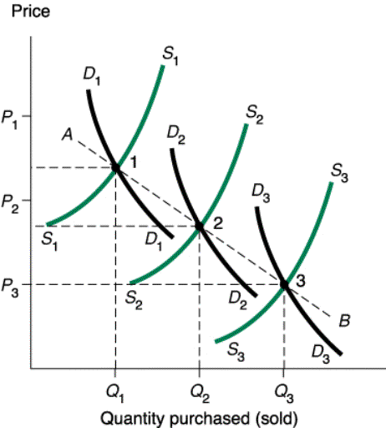
1.3 reciprocal causation
Reason3： Reciprocal Causation
Case1：Demand Curve
邹至庄、牛霖琳，2010，“中国城镇居民住房的需求与供给”，《金融研究》第1期
We want to estimate Demand Curves DD(They depend on other factors, and therefore DiDi), but we can only observe dot 1,2,3, and hence line AB.
In the simultaneous-equations model
q_{s} = a₁p + b₁ z₁ + u₁
q_{d} = a₂p + b₂ z₂ + u₂
q_{d} = q_{s} =q
P is the price, and Z1 is the supply shock, Z2 is the demand shock
In equilibrium, p and q is determined at the same time

Slide 8


1.3 reciprocal causation
In equilibrium, the demand curve is q = α₁p + β₁ z₁ + u₁ , and the price p is correlated to error term u1.
The equation can be rewritten as follow:

Slide 9
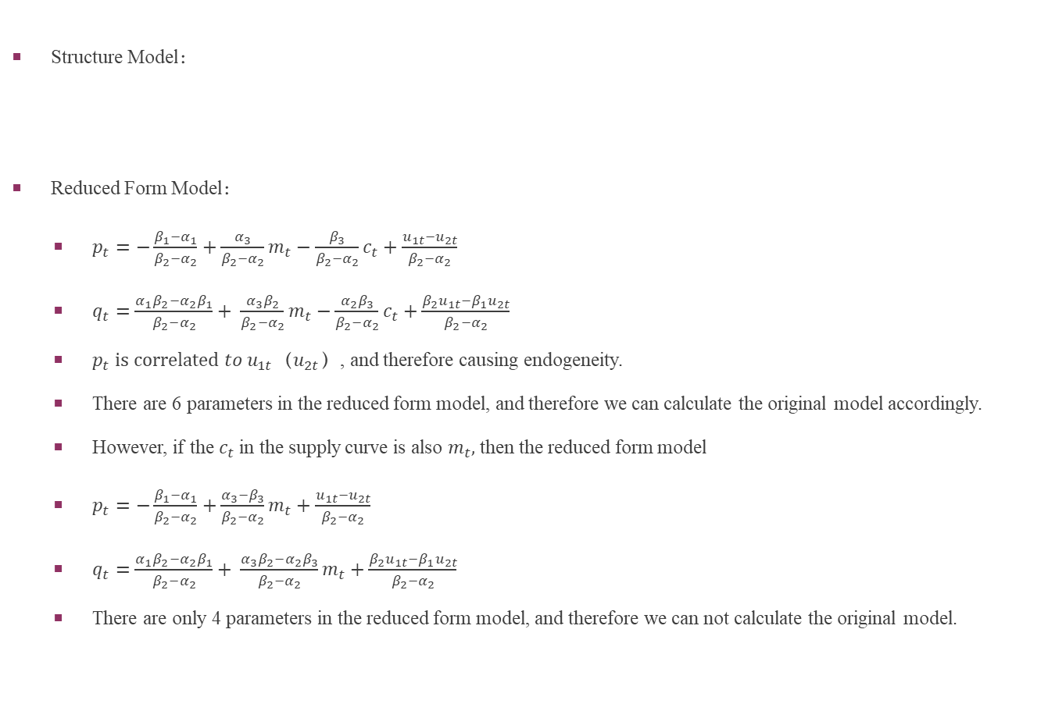
1.3 reciprocal causation
Structure Model：
Reduced Form Model：
$p_{t}=−\frac{β_{1}−α_{1}}{β_{2}−α_{2}}+\frac{α_{3}}{β_{2}−α_{2}}m_{t}−\frac{β_{3}}{β_{2}−α_{2}}c_{t}+\frac{u_{1t}−u_{2t}}{β_{2}−α_{2}}$
$q_{t}=\frac{{α_{1}β}_{2}−{α_{2}β}_{1}}{β_{2}−α_{2}}+ \frac{{α_{3}β}_{2}}{β_{2}−α_{2}}m_{t}−\frac{{α_{2}β}_{3}}{β_{2}−α_{2}}c_{t}+\frac{β_{2}u_{1t}−β_{1}u_{2t}}{β_{2}−α_{2}}$
$p_{t}$ $is correlated to u_{1t}$（$u_{2t}$）, and therefore causing endogeneity.
There are 6 parameters in the reduced form model, and therefore we can calculate the original model accordingly.
However, if the $c_{t}$in the supply curve is also $m_{t},$ then the reduced form model
$p_{t}=−\frac{β_{1}−α_{1}}{β_{2}−α_{2}}+\frac{α_{3}−β_{3}}{β_{2}−α_{2}}m_{t}+\frac{u_{1t}−u_{2t}}{β_{2}−α_{2}}$
$q_{t}=\frac{{α_{1}β}_{2}−{α_{2}β}_{1}}{β_{2}−α_{2}}+ \frac{{α_{3}β}_{2}−{α_{2}β}_{3}}{β_{2}−α_{2}}m_{t}+\frac{β_{2}u_{1t}−β_{1}u_{2t}}{β_{2}−α_{2}}$
There are only 4 parameters in the reduced form model, and therefore we can not calculate the original model.

Slide 10
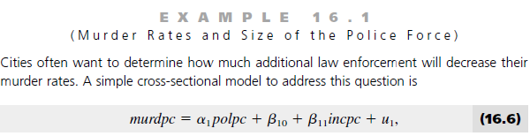
1.3 reciprocal causation
If we neglect the 2nd model and only analyze the 1st model, and this will lead to endogenous problem.

Slide 11

1.4 measurement error
Reason4： Measurement Error
But we do not observe x directly, we can only see a representative variable Zi
If we regress y on z, then ,but true model is

Slide 12
1.4 measurement error
Empirical implication:
Beta is biased toward zero.
The larger the sd of observation error, the larger the bias.
If there exists observation error and still gets significant results, considering the error will strengthen the conclusion.

Slide 13
1.4 measurement error
In the above single-element regression model, beta1 is inconsistent and so is beta0.
In the multiple regression model, if there are observation errors in multiple variables, we have no empirical conclusion about the endogenous problem.

Slide 14
1.5 lagged dependent variables
Reason 5：lagged dependent variables in the presence of autocorrelation in the error term.
That is, the error term is related to future dependent variables. This is also endogenous.
We will discuss the time series data in the future

Slide 15
1.6 Sample selection bias
Reason 6：Sample selection bias
Survivorship bias is a common type of sample selection bias. This type of bias ignores those subjects that did not make it past a certain point in the selection process and only focuses on the subjects that "survived." This can lead to false conclusions.
For example, when backtesting an investment strategy on a large group of stocks, it may be convenient to look for securities that have data for the entire sample period. If we were going to test the strategy against 15 years worth of stock data, we might be inclined to look for stocks that have complete information for the entire 15-year period. However, eliminating a stock that stopped trading, or shortly left the market, would input a bias in our data sample. Since we only include stocks that lasted the 15-year period, our final results would be flawed, as these performed well enough to survive the market.
The former 5 endogenous problems involve a correlation between independent variable and error term.
The selection bias involves a correlation between sample selection and error term. We will discuss this bias in detail in the future.
The IV（instrument variable) method introduced today mainly solves endogeneity for the first four endogenous problems

Slide 16
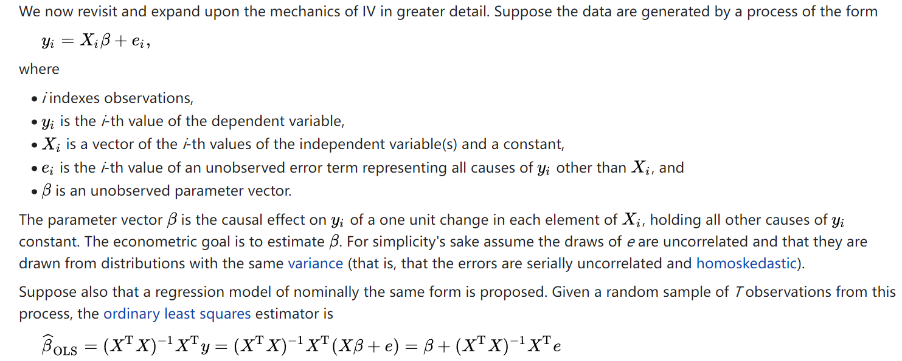
2.1 IV estimation

Slide 17
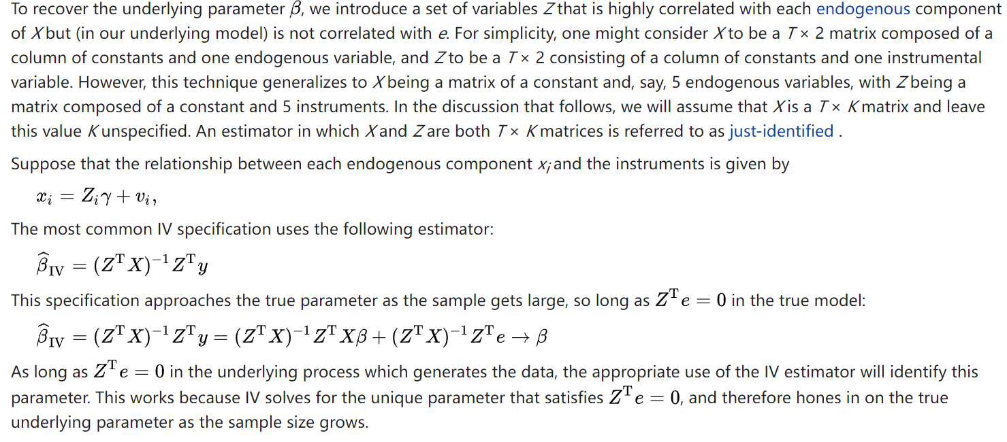
2.1 IV estimation

Slide 18
2.2 IV estimation - Unbiasedness?
Properties of IV estimation
Unbiasedness?
The conditional mean is not zero.

Slide 19
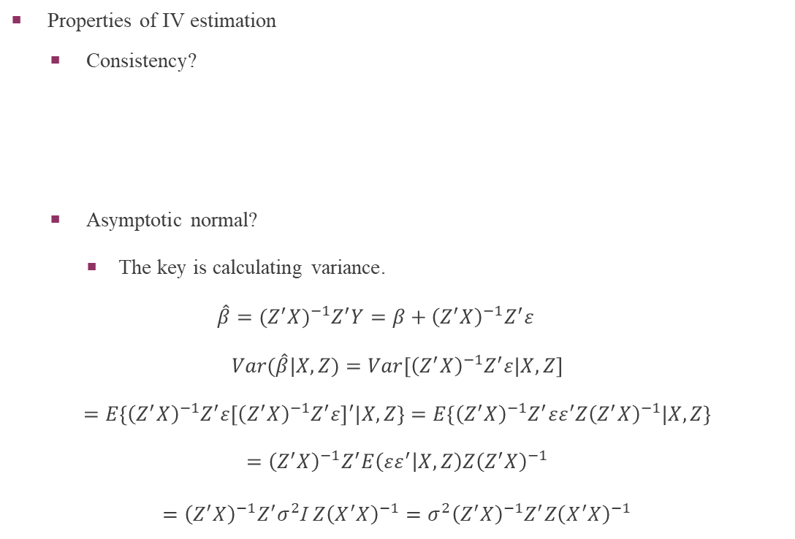
2.2 IV estimation - Consistency
Properties of IV estimation
Consistency?
Asymptotic normal?
The key is calculating variance.
$$\hat{β}={(Z^{′}X)}^{−1}Z^{′}Y=β+{\left(Z^{′}X\right)}^{−1}Z^{′}ε$$
$$Var(\hat{β}|X,Z)={Var[\left(Z^{′}X\right)}^{−1}Z^{′}ε|X,Z]$$
$$={E\{\left(Z^{′}X\right)}^{−1}Z^{′}ε{\left[{\left(Z^{′}X\right)}^{−1}Z^{′}ε\right]}^{′}|X,Z\}=E\left\{{\left(Z^{′}X\right)}^{−1}Z^{′}εε^{′}Z{\left(Z^{′}X\right)}^{−1}|X,Z\right\}$$
$$={\left(Z^{′}X\right)}^{−1}Z^{′}E\left(εε^{′} | X,Z\right)Z{\left(Z^{′}X\right)}^{−1}$$
${={\left(Z^{′}X\right)}^{−1}Z^{′}σ}^{2}$I $Z{\left(X^{′}X\right)}^{−1}=σ^{2}{\left(Z^{′}X\right)}^{−1}Z^{′}Z{\left(X^{′}X\right)}^{−1}$

Slide 20
2.2 IV estimation - Asymptotic normal
Properties of IV estimation
Asymptotic normal? （渐进正态性）
The standard error is also consistent.
Inference based on IV estimation
Asymptotic t-test
Asymptotic Wald test

Slide 21
2.3 IV estimation – criterion of IV
Criterion of IV
1. Z should be highly correlated to X.
Economic Sense：Z should have an impact on x.
2. Z should be uncorrelated to error term.
Economic Sense：Z should only have an impact on Y through affecting x.

Slide 22
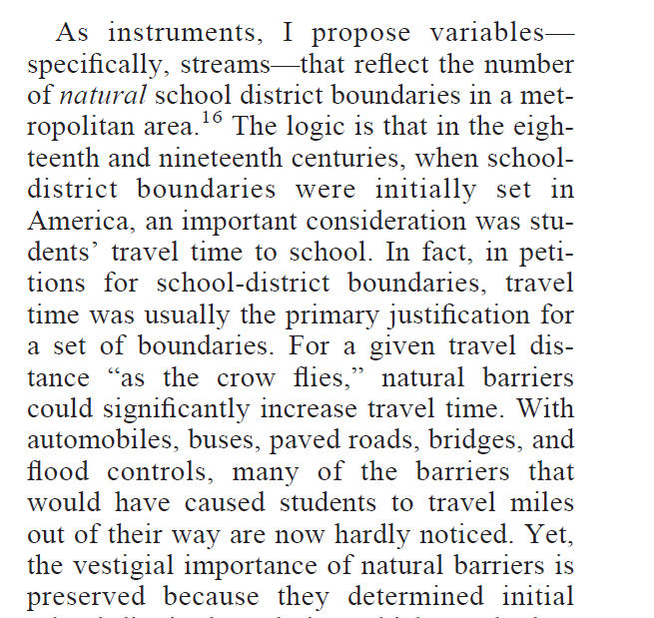
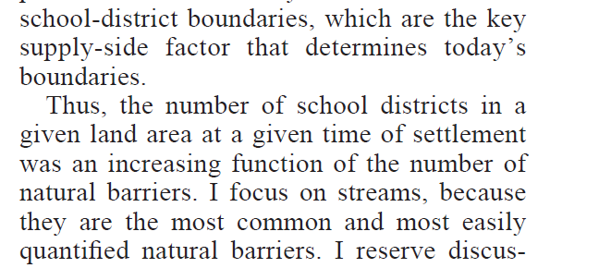
2.4 IV estimation – CASE1
Hoxby C M. Does competition among public schools benefit students and taxpayers?[J]. American Economic Review, 2000, 90(5): 1209-1238.
Notes:
采用区域内河流数量作为该区域学校数量的工具变量，以此来验证学区内的学校竞争是否可以提高教学质量。区域内学校数量之所以是内生的，是因为它可能是该区域长期历史积累下的某种特征的结果。而使用河流数作为工具变量则具有很强的说服力:河流数量越多，就会因交通问题导致更多学校的设立; 但河流数是天然形成的，本身和教学质量无直接关系。

Slide 23
2.4 IV estimation – CASE2
The author chooses whether students grow up near the university as an instrumental variable of the number of years of education.
The reason is that students who do not grow up near the university will have higher costs to go to university. These higher costs will reduce their college attendance, which is at least true for students with low family income.
Card D. Using geographic variation in college proximity to estimate the return to schooling[J]. 1993.

Slide 24
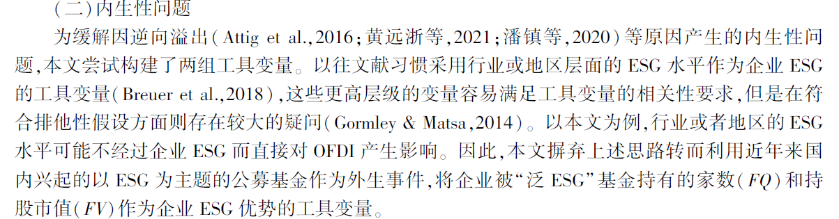
2.4 IV estimation – CASE3
[1]谢红军,吕雪.负责任的国际投资：ESG与中国OFDI[J].经济研究,2022,57(03):83-99.

Slide 25
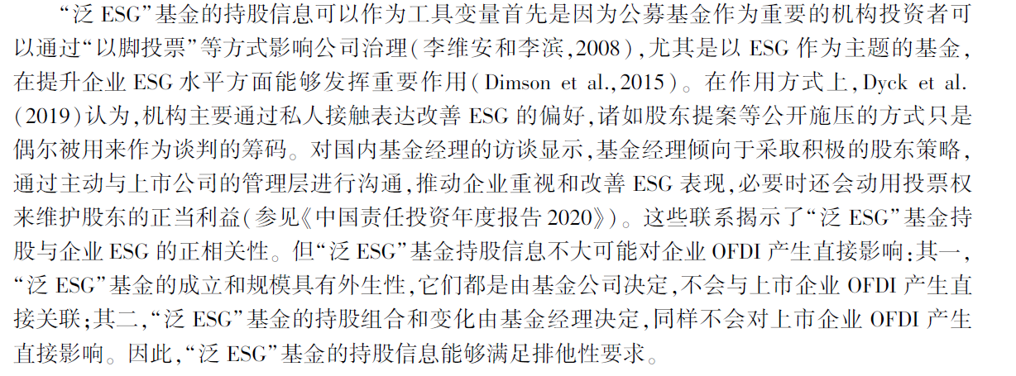
2.4 IV estimation – CASE3

Slide 26
3 Two Stage Least Squares
What if we have more than one IV candidates for one endogenous explanatory variable?
Linear combination surely satisfies the IV condition
Some linear combination have larger correlation with the corresponding endogenous variable, which one has the largest?
OLS
Consider y₁ = b₀ + b₁y₂ + b₂z₁ + u₁, where y₂ is endogenous and z₁ is exogenous and both z₂ and z₃ are valid instruments
they do not appear in the structural model and are uncorrelated with the structural error term, u₁
We can estimate ŷ₂ by regressing y₂ on z₁, z₂ and z₃ : y₂ = p₀ + p₁z₁ + p₂z₂ + p₃z₃ + v₂
can call this the first stage
Then use ŷ₂ as IV for y₂

Slide 27
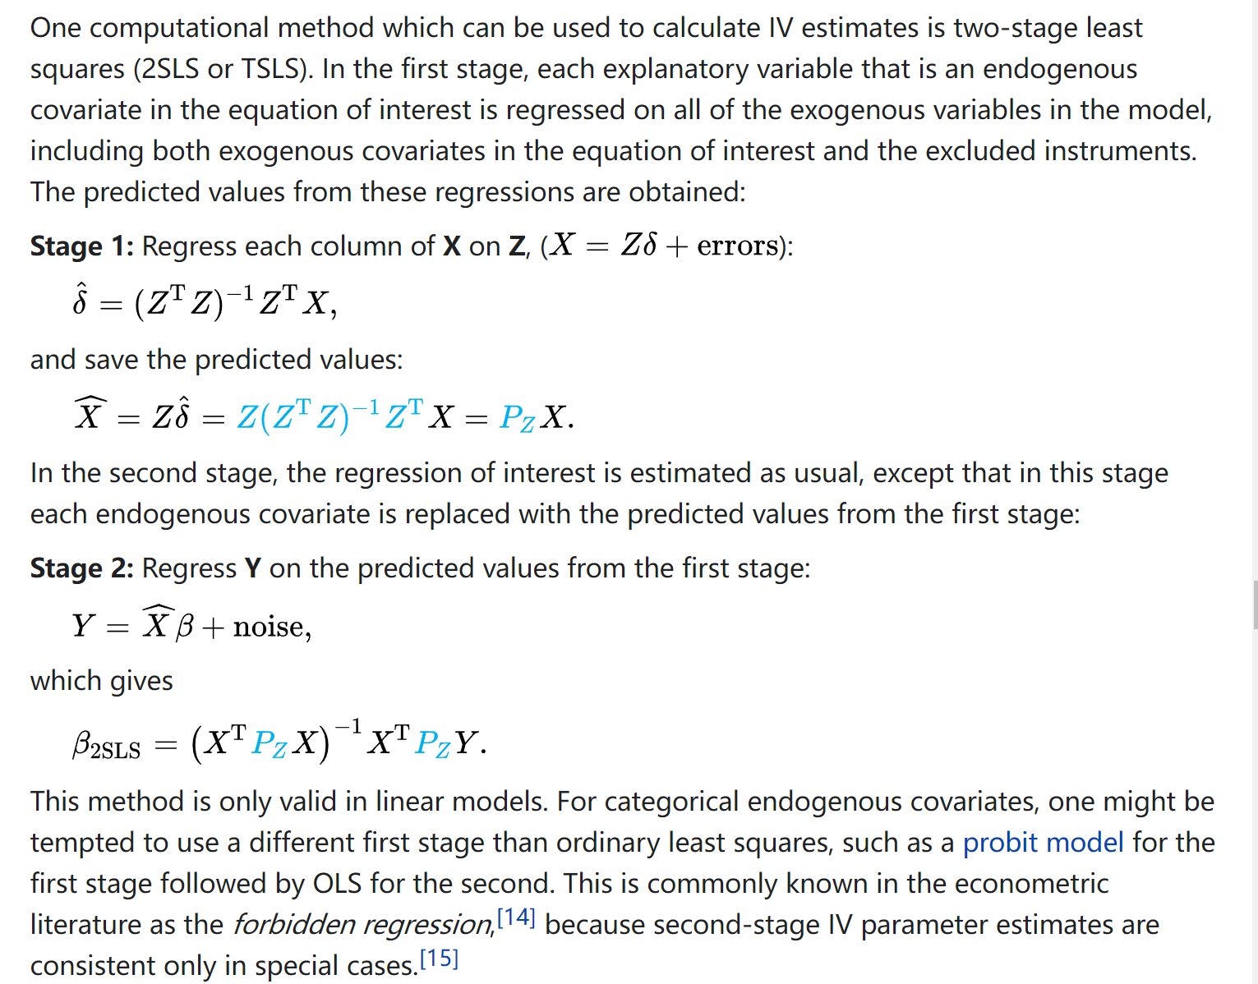
3 Two Stage Least Squares

Slide 28
4.1 Two specification tests
OLS is unbiased and more efficient than IV when there is no endogeneity problem.
Therefore, we’d like to be able to test for endogeneity.
Endogeneity test 1：Hausman test
If we do not have endogeneity, both OLS and IV are consistent, and OLS is mor efficient.
If we have endogeneity, IV is consistent, but OLS is not.
Idea of Hausman (1978) test is to see if the estimates from OLS and IV are significantly different.
That is, calculate the distance between the two estimates (weighted sum of squares)
The large sample theory tells us that this formula obeys the distribution of kai-square.
Under Ho: No endogeneity, both consistent, no big difference.
Under H1: OLS is inconsistent, so the difference is significant
Hausman test can also be applied to Panel Data.

Slide 29
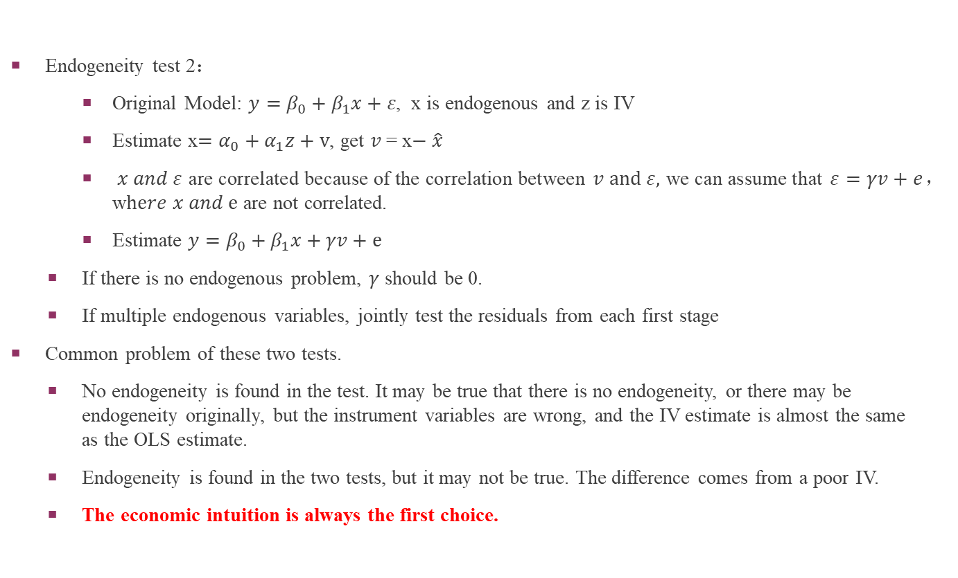
4.1 Two specification tests
Endogeneity test 2：
Original Model: $y=β_{0}+β_{1}x+ε$, x is endogenous and z is IV
Estimate x$=α_{0}+α_{1}z+v$, get $v$= x$− \hat{x}$
$x and ε$are correlated because of the correlation between $v and ε,$we can assume that $ε=γv+e$，w$here x and e$ are not correlated.
Estimate $y=β_{0}+β_{1}x+γv+e$
If there is no endogenous problem, $γ$ should be 0.
If multiple endogenous variables, jointly test the residuals from each first stage
Common problem of these two tests.
No endogeneity is found in the test. It may be true that there is no endogeneity, or there may be endogeneity originally, but the instrument variables are wrong, and the IV estimate is almost the same as the OLS estimate.
Endogeneity is found in the two tests, but it may not be true. The difference comes from a poor IV.
The economic intuition is always the first choice.

Slide 30
4.2 Two specification tests - OverID
As mentioned earlier, if we find multiple IV's for one endogenous variable, the best way is to use all these IV's through the 2SLS method.
Is it the more you use, the better?
If the newly added IV does not meet the standards for IV? Obviously, we should not add them if they do not satisfy the two standards (相关性与外生性).
So we need a method to test the condition of multiple instrumental variables.
If we have two instruments, it is possible to see if the second instrument is correlated with the error
Run ivreg using the first IV, and save the error
Run regression of second IV on the error
If 2nd IV is valid, it should not be significant in the second regression
Notes:
如果iv是valid的，那么应该与残差项无关。否则相当于还会通过其他渠道影响y？

Slide 31
4.2 Two specification tests - OverID
The OverID Test in general (Sargan tests)
Estimate the structural model using IV and obtain the residuals
Regress the residuals on all the exogenous variables and obtain the R² to form nR²
Under the null that all instruments are uncorrelated with the error, LM ~ c_{q}² where q is the number of extra instruments (# of IV’s - # of endogenous variables)
How to use OverID test?
the tests assume that at least one IV is valid
unfortunately this assumption cannot be tested
Such tests can be used in the following two cases.：
Adding more IVs？Bound, Jaeger and Baker (1995) find that Angrist and Krueger (1991) used too many IVs
Excluding IV? If the second IV isn’t valid, we may also doubt the first one

Slide 32
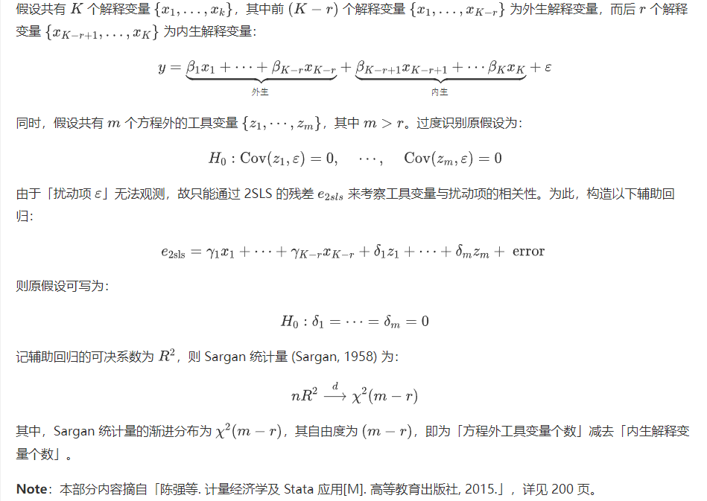
4.2 Two specification tests - Sargan

Slide 33
4.2 Two specification tests
When testing instrument validity (overid) and endogeneity bias (ivendog), it is important to consider your sample size:
in large samples, the tests may reject a null hypothesis that is “nearly true”.
“over significant” also exists in OLS
in small samples, the tests may fail to reject a null hypothesis that is “very false”.
Therefore, the economic intuition is always the first choice.
It’s recommend that formal tests for instrument validity and endogeneity should be supplemented with sensitivity analyses. For example, researchers should:
report both the OLS and IV results
examine whether the results are sensitive to using different instrumental variables

Slide 34
5 code and reference
[1] Data Description: Sales prices of houses sold in the city of Windsor, Canada, during July, August and September, 1987.
Original Source: Anglin, P., and Gencay, R. (1996). Semiparametric Estimation of a Hedonic Price Function. Journal of Applied Econometrics, 11, 633–648.
[2] statsmodels Python package: Seabold, Skipper, and Josef Perktold. (2010). “statsmodels: Econometric and statistical modeling with python”. Proceedings of the 9th Python in Science Conference.
[3] linearmodels Python package: Kevin Sheppard. (2021). “Linear (regression) models for Python. Extends statsmodels with Panel regression, instrumental variable estimators, system estimators and models for estimating asset prices”. Python package version 4.25.

